Slide 1
GitLab CI/CD: Workflow vs Agentic System
By: Ayushi Saxena

Slide 2
Introduction

Slide 3
In modern software development, we follow many repeatable processes—like code commits, CI/CD pipelines, and merge approvals. While these workflows are reliable, they often involve repetitive manual steps.
GitLab CI/CD is one such core workflow in our projects, where developers push code, wait for pipelines to run, raise merge requests, and wait for reviews. This process is predictable - but also time-consuming.
With the rise of LLM-powered agents, we now have a new way: intelligent systems that observe, decide, and act - not just follow fixed steps. These agentic systems can streamline workflows, reduce manual effort, and even make decisions on our behalf based on context.
In this comparison, we’ll explore:
How traditional GitLab workflows function
How the same process could be redesigned using an agentic system
When to use one vs the other—based on reliability, speed, and flexibility

Slide 4
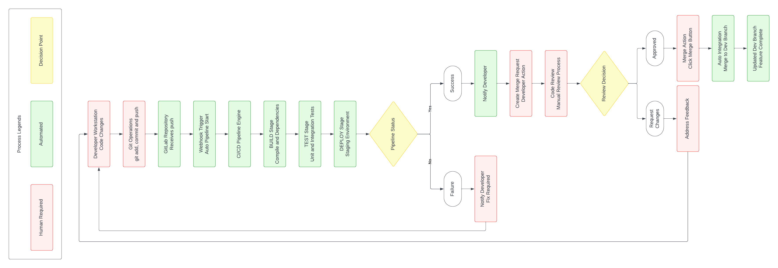
Traditional Workflow
Fixed and repeatable flow that depends on manual triggers and approvals.

Slide 5
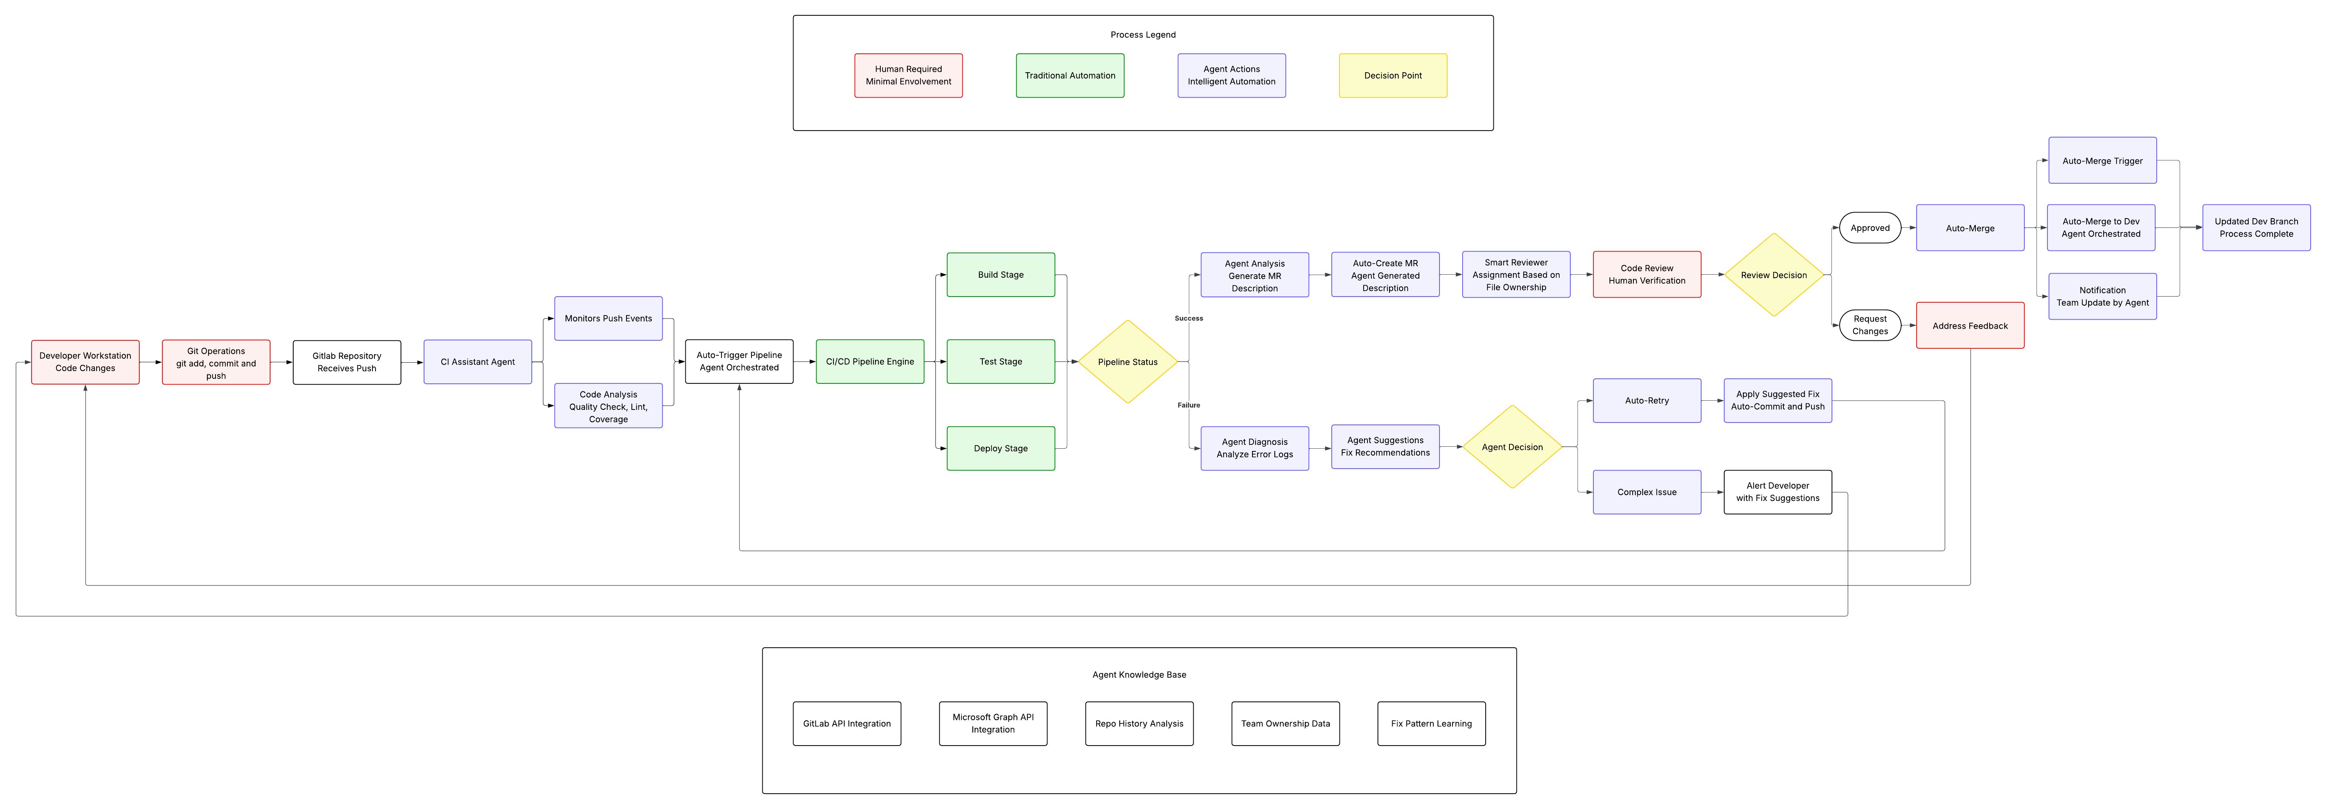
Agentic System

Slide 6



Agent Knowledge Base – Tools and Real-World Usage
Tool | Purpose | How the agent uses it?
GitLab API | Track code pushes, MR’s, pipelines | Auto-creates MR when dev pushes code → Adds summary → Tags reviewer based on past MRs
Microsoft Graph API | Send emails & check calendar availability | Sends Outlook email: “MR for Registration Form merged to dev.” Skips reviewer if they're OOO
Repo History Analysis ( Git CLI + GitLab API) | Analyze file change frequency, past authors, test failures | Sees Priya worked on StudentForm.js 3 times → Auto-assigns her to review
Team Ownership Data (CODEOWNERS, Internal Map) | Identify who owns which module/file | Bug in PaymentService.cs → Agent sees Ayushi is the owner from CODEOWNERS → Assigns to her automatically

Slide 7

Traditional Workflow vs Agentic System – What’s the Real Difference?
Traditional Workflow (Scripted, Step-by-Step)
“You do the task. You trigger the pipeline. You follow up. Every time.”
Developer writes code → commits → pushes
CI/CD runs automatically, but everything after is manual:
Manually raise MR
Find and tag the right reviewer
Email the team on merge
If something breaks? You open the logs and figure it out yourself
"It works, but it’s slow. And if I’m stuck or someone's out of office, everything waits."

Slide 8

Traditional Workflow vs Agentic System – What’s the Real Difference?
Agentic System (Smart, Context-Aware)
“You focus on code. The agent does the rest.”
Detects your push and understands the change
Auto-generates a detailed MR with proper title and summary
Assigns the reviewer intelligently (based on file ownership/history)
Sends an Outlook update once it’s merged
If tests fail, it analyses the logs and either:
Suggests fixes
Or retries automatically
"It’s like having an AI teammate who watches your back and speeds up boring tasks."

Slide 9
So, When Do You Use Which?
Use Traditional Workflow When:
Projects with strict checkpoints (e.g., healthcare, finance)
Environments where human review is a must at every step
Your pipeline is simple, and the team is small
Teams that are new, growing, or still learning the codebase
Use Agentic System When:
Cross-timezone or hybrid teams
Delays happen because people are on leave, in meetings, or switching tasks
You want to spend time building, not babysitting pipelines
Your team is experienced and spends too much time on repetitive tasks

Slide 10

Thank You
Ayushi Saxena
ayushisaxena@presidio.com

